Slide 1



Content Analysis

Slide 2


Today's agenda
Project recap
Problem
The Analytics team
Process
Insights
Summary

Slide 3

.
Analyze user interactions on Social Buzz across content types for the top 5 categories with the highest aggregate popularity. Deliver insights through visualizations, aiding strategic content optimization
Project Recap

Slide 4

Problem
With 24 thousand plus content and 1000 views per month the platform as out performed.
Top 5 Categories.
But, are numbers are constant ?
Is there genuine affection for videos?

Slide 5



Marcus Rampton
Senior Principal
The Analytics team
Michelle Grove
Data Scientist
Varun S Patil
Data Analyst

Slide 6
Process
1
Data Extraction
2
Data Transformation
3
Data Cleaning and Loading
4
Data Analysis
5
Insights and Conclusions

Slide 7

Insights
Animal , Food and Science remain most watched for two years 2020 and 2021.
In 2020 along with above three Healthy eating and Travel are top 5 categories. But in 2021 Technology and Culture mark their positions.
The Positive to negative review ratio is 1.8:1 on average . It means for each 2 positive review you get 1 negative review.
Technology has highest ratio of 1.9 .
The ratio of least viewed categories is also around average.

Slide 8
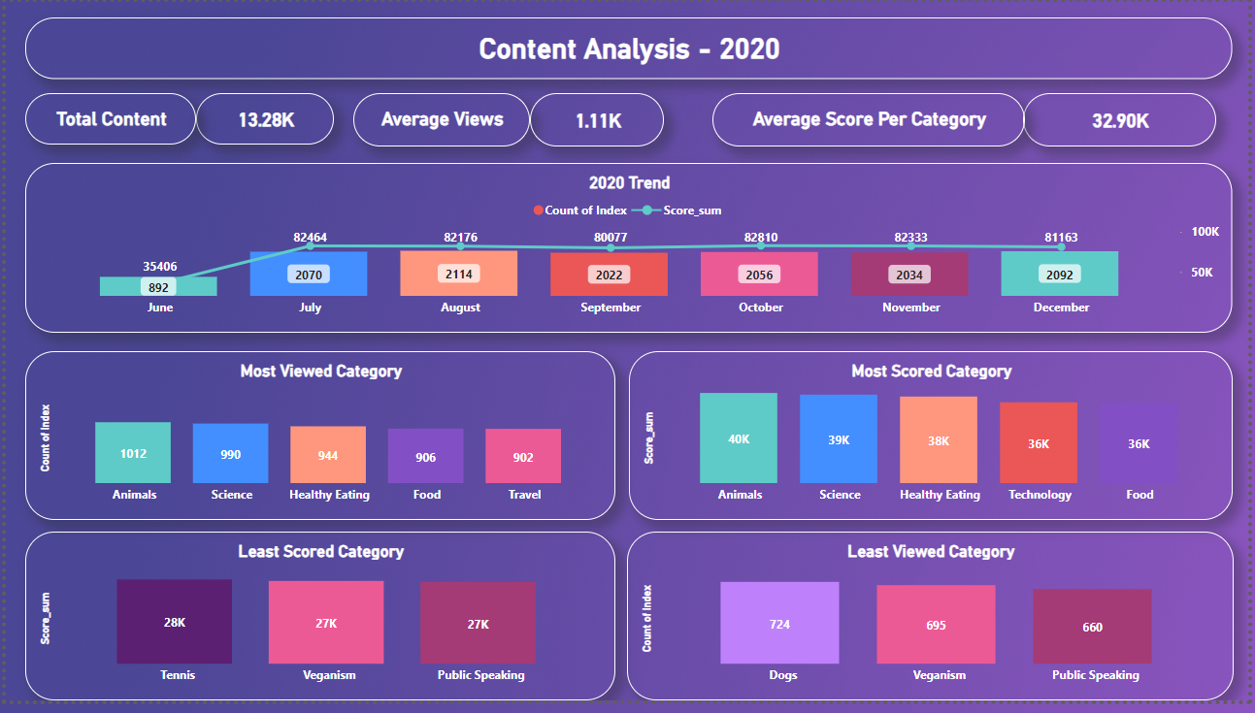
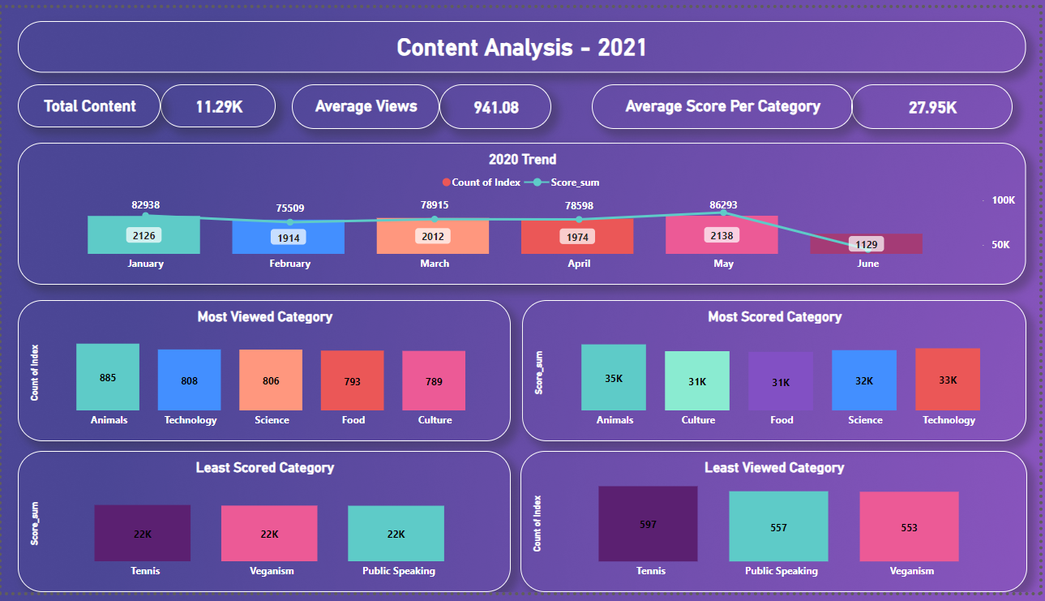

Slide 9
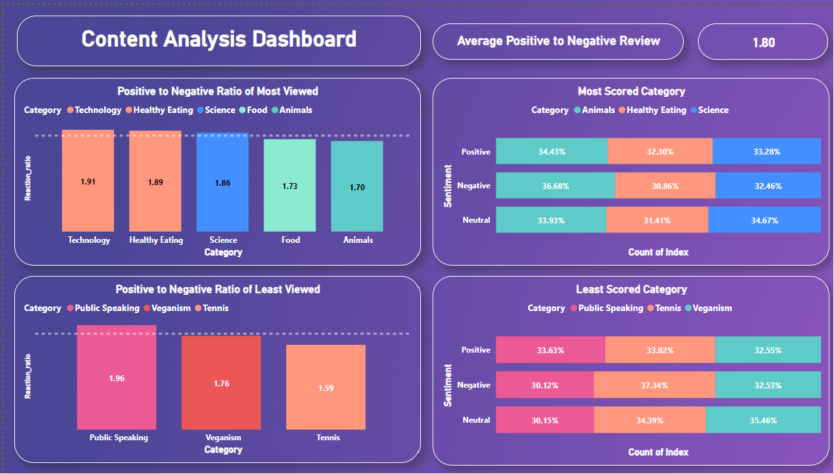

Slide 10

The Animal , Science and Food are most watched categories.
The Animal category is most viewed and highly positively reviewed .
The June has the least traffic in 2020 and 2021 .
The content quality should be taken care as the ratio of positive to negative review is 1.8.
The least viewed categories have similar trend of ratio.
Summary

Slide 11
Thank you!
ANY QUESTIONS?

